Slide 1
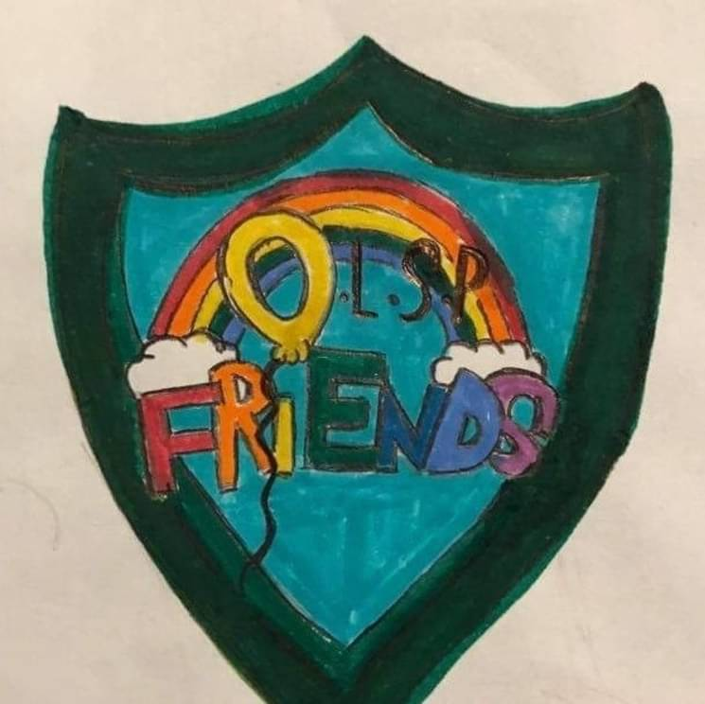
FRIENDS NEWS
Thank you to everyone who was able to attend the disco on Friday night. We hope you had a lot of fun raising money for the Friends to enable us to support the activities in the school. A huge thank you to all the lovely volunteers who made the night possible. You really do make such a difference! If you would like to get involved with any of our events, please do email friends@olsp.uk as we would love to hear from you!
We also hope you enjoyed your superwoman mother's Day gifts. Once again, thanks to the team who chose such thoughtful gifts for the children to buy.
Tomorrow is Bag2
Tuesday 21st March - Bag2School
All donations to be at school before 9am.
Friday 5th May - Coronation Celebrations!
Easter Egg Trail - Throughout the Easter holidays
Thursday 13th June - Superman (Fathers Day) Gift Shop
Friday 7th July - SUMMER BBQ!

